Slide 1
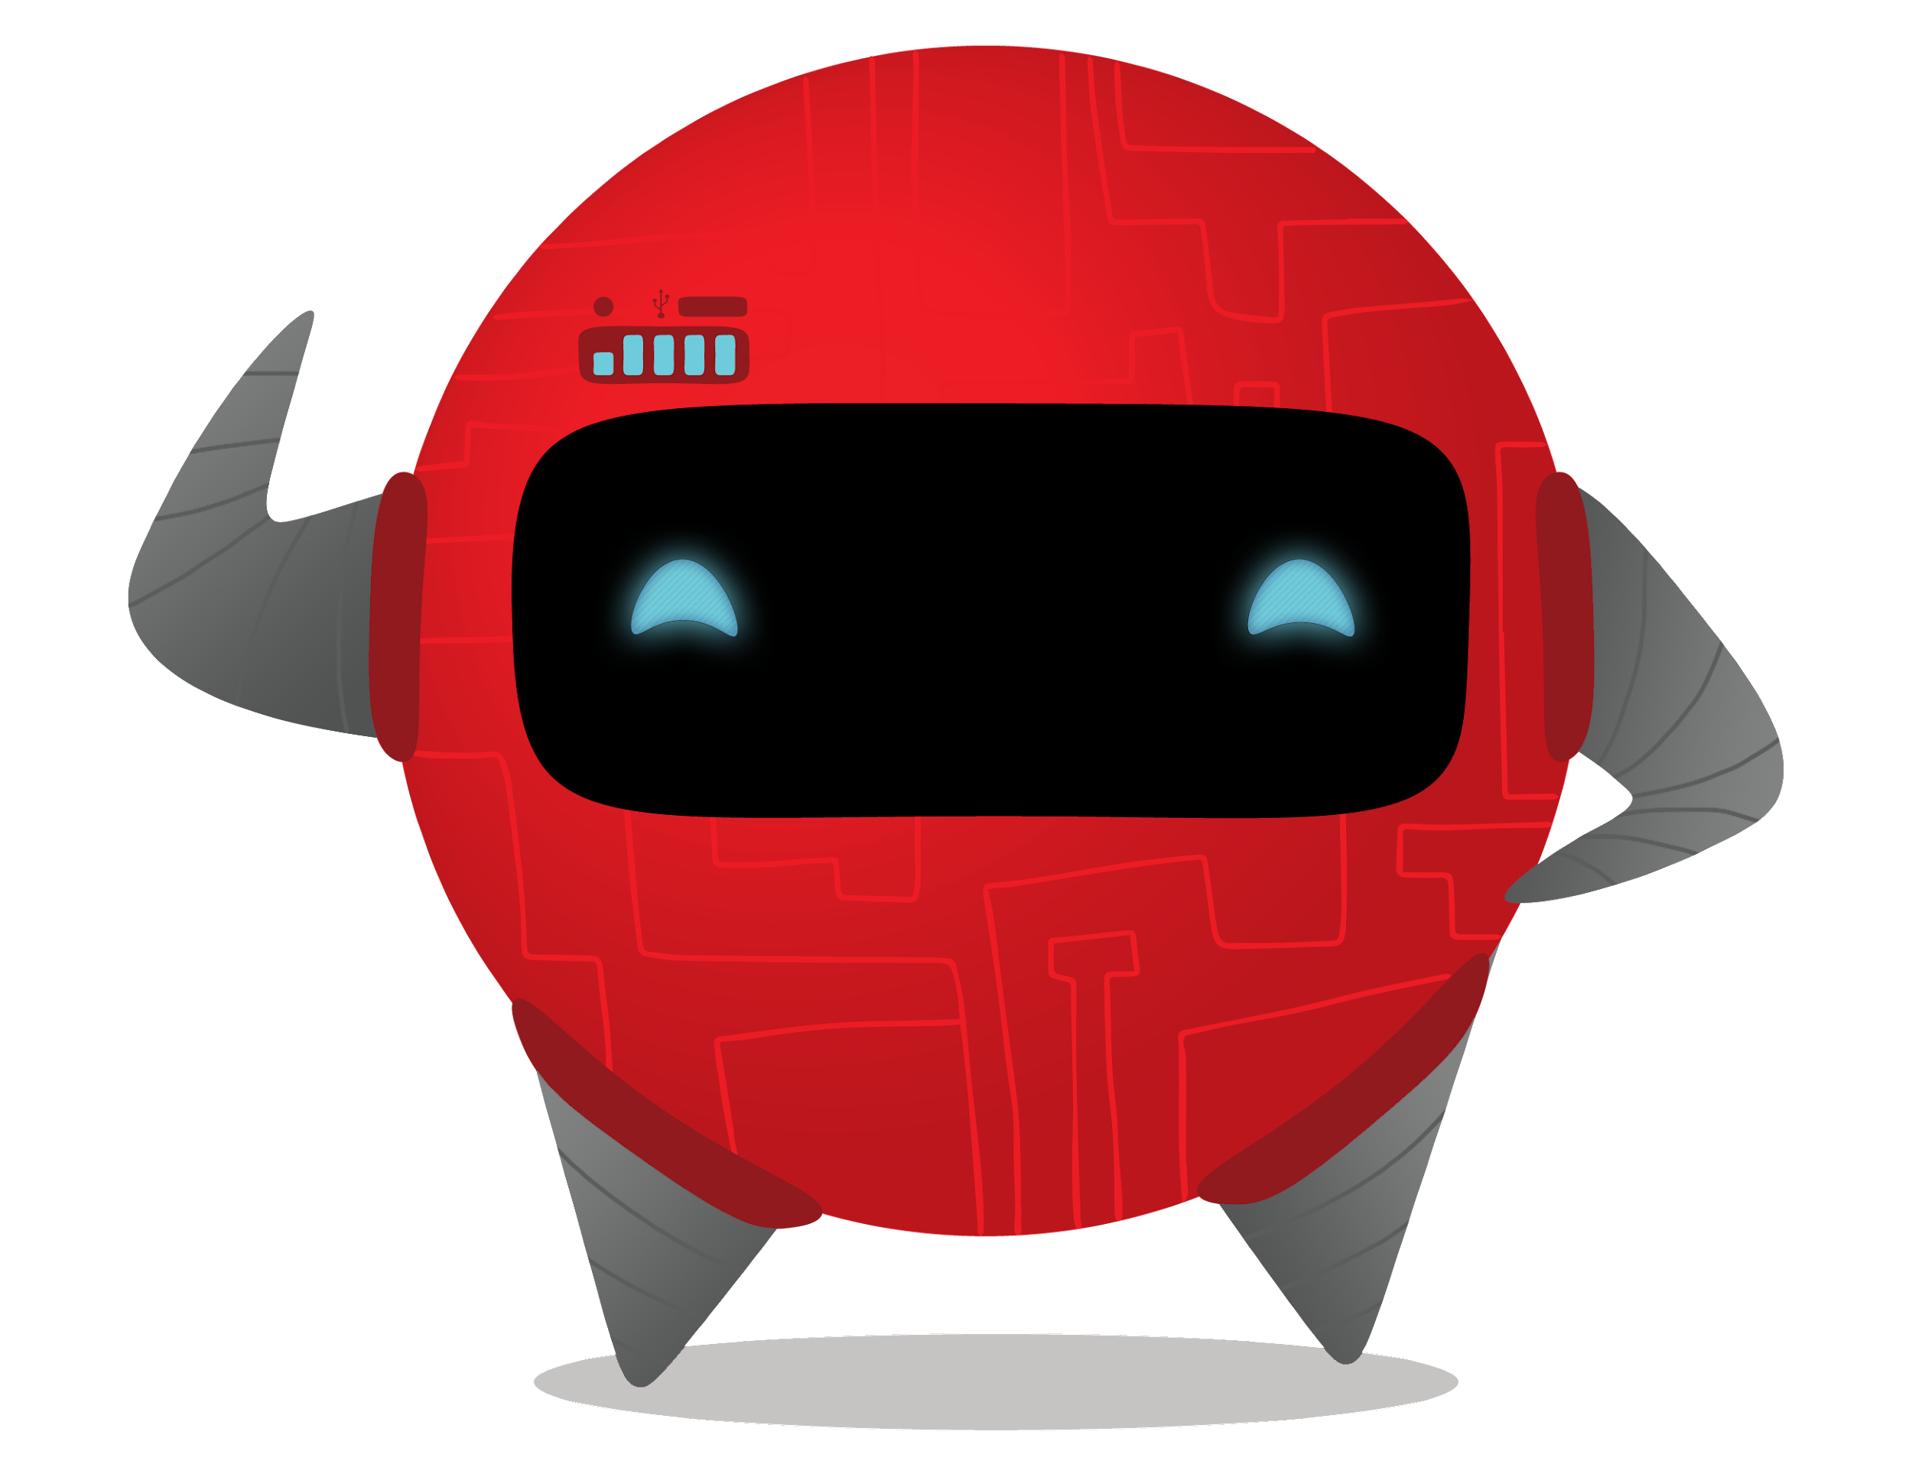

Welcome Tom!
•Senior Systems Engineer•

Slide 2
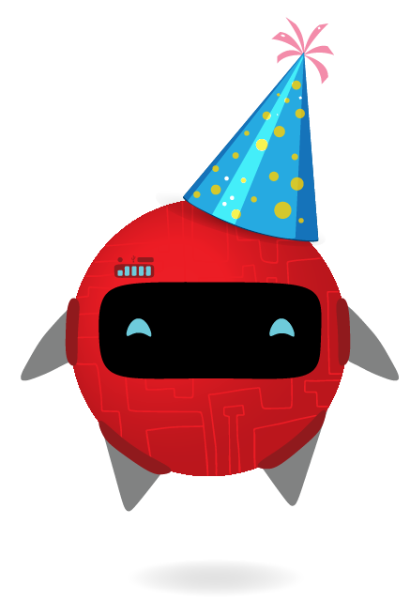
Who am I?
Name:
When do you start:
Previous job:
Your first ever job:
Is there a cultural day that you celebrate? What is it?
Fun Caption

Slide 3
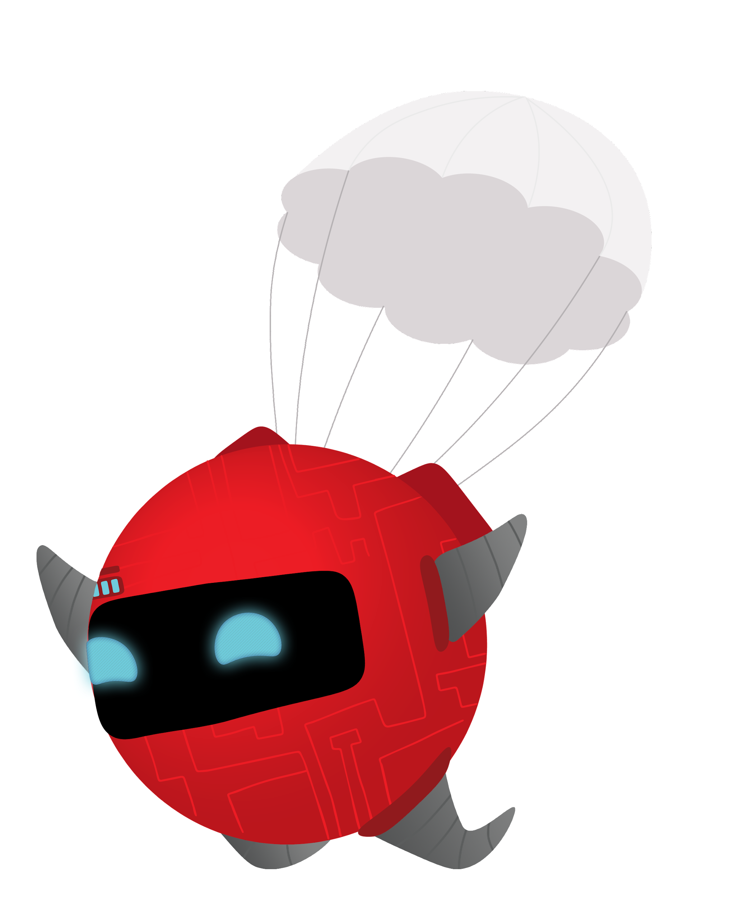
Q. Where did you grow up?
A. Q. What is the most used emoji on your phone right now?
A.
Q. What is something you cannot live without?
A.
Q. What simple thing still blows your mind?
A.
Q. Have you ever had a nickname? What is it?
A.
Q. Favourite activity away from the office? A.
Q. What’s an adventurous thing you have done?
A.

Slide 4
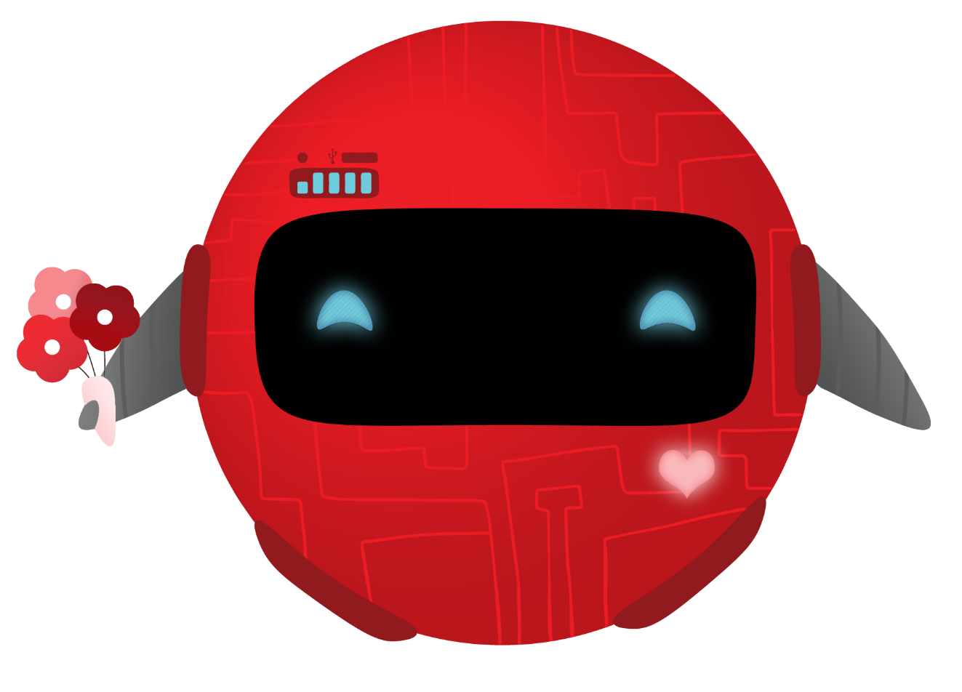
Would you rather:
Would you rather oceans or mountains? Why?
Would you rather know and speak all languages, or be able to speak with animals?
Would you rather talk like Yoda or breathe like Darth Vader?
Would you rather telekinesis (the ability to move things with your mind) or telepathy (the ability to read minds)?

